Slide 1


Slide 2
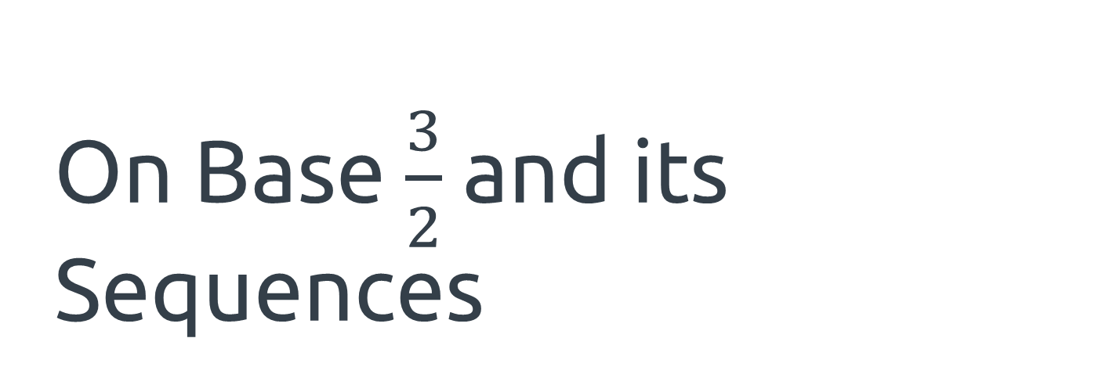
On Base $\frac{3}{2}$ and its Sequences
By: Poonam, Ben, Neil, Armaan, Nathan, Richard, Anuj, Shane, Nastia, Josh
with mentor Tanya Khovanova
PRIMES Conference: 5/20/18
Notes:
Nastia

Slide 3
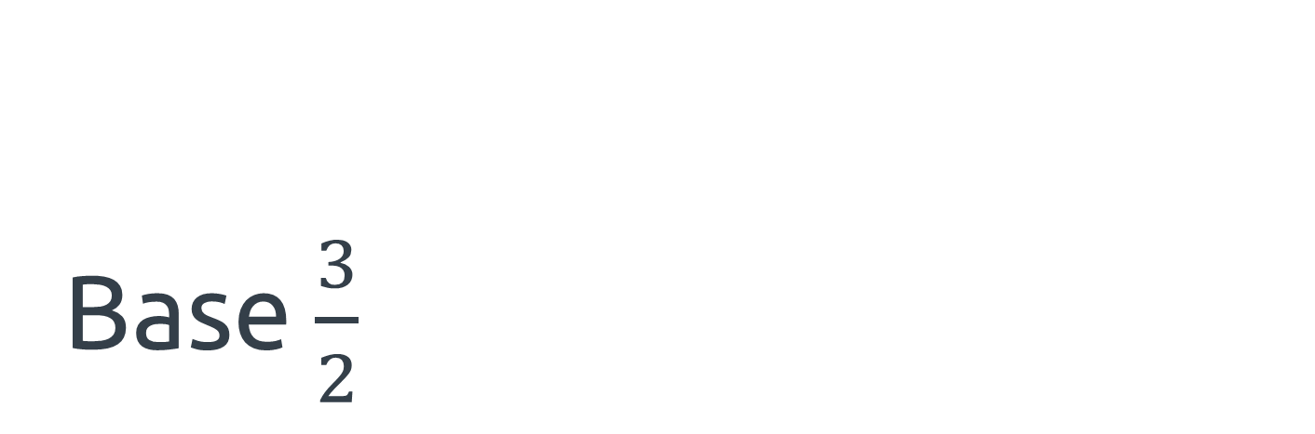
Base $\frac{3}{2}$
The representation system, exploding dots, and the tree
Notes:
Nastia

Slide 4

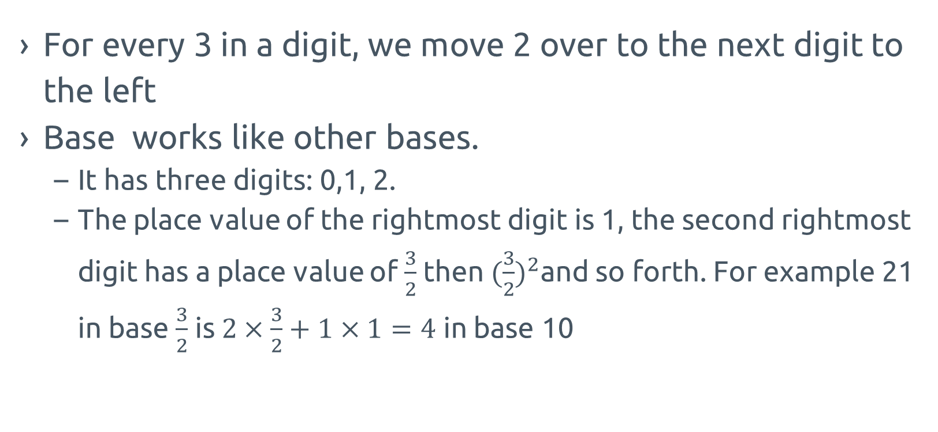
Base $\frac{3}{2}$ Explanation
For every 3 in a digit, we move 2 over to the next digit to the left
Base works like other bases.
  It has three digits: 0,1, 2.
  The place value of the rightmost digit is 1, the second rightmost digit has a place value of $\frac{3}{2}$ then $({\frac{3}{2})}^{2}$and so forth. For example 21 in base $\frac{3}{2}$ is $2×\frac{3}{2}+1×1=4$ in base 10
1 | 2 | 3 | 4 | 5 | 6 | 7 | 8 | 9 | 10 | 11 | 12 | 13 | 14 | 15
1 | 2 | 20 | 21 | 22 | 210 | 211 | 212 | 2100 | 2101 | 2102 | 2120 | 2121 | 2122 | 21012
Notes:
Richard

Slide 5
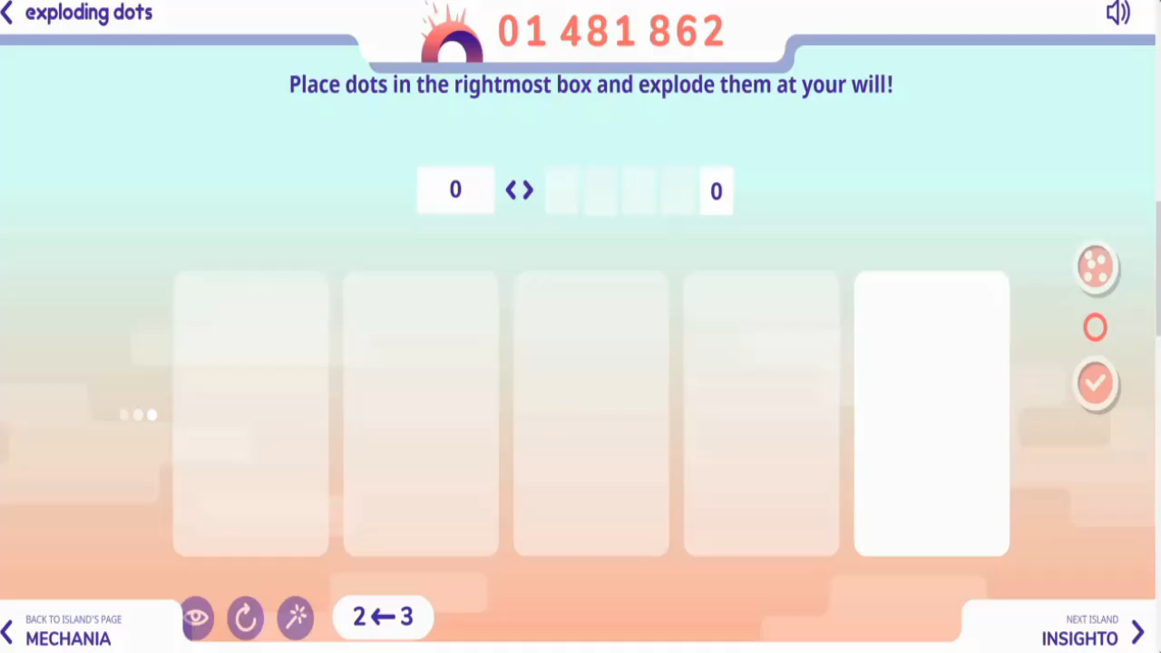
Exploding Dots
Notice how every 3 dots “explode” into two dots in the next place value
Notes:
Richard

Slide 6
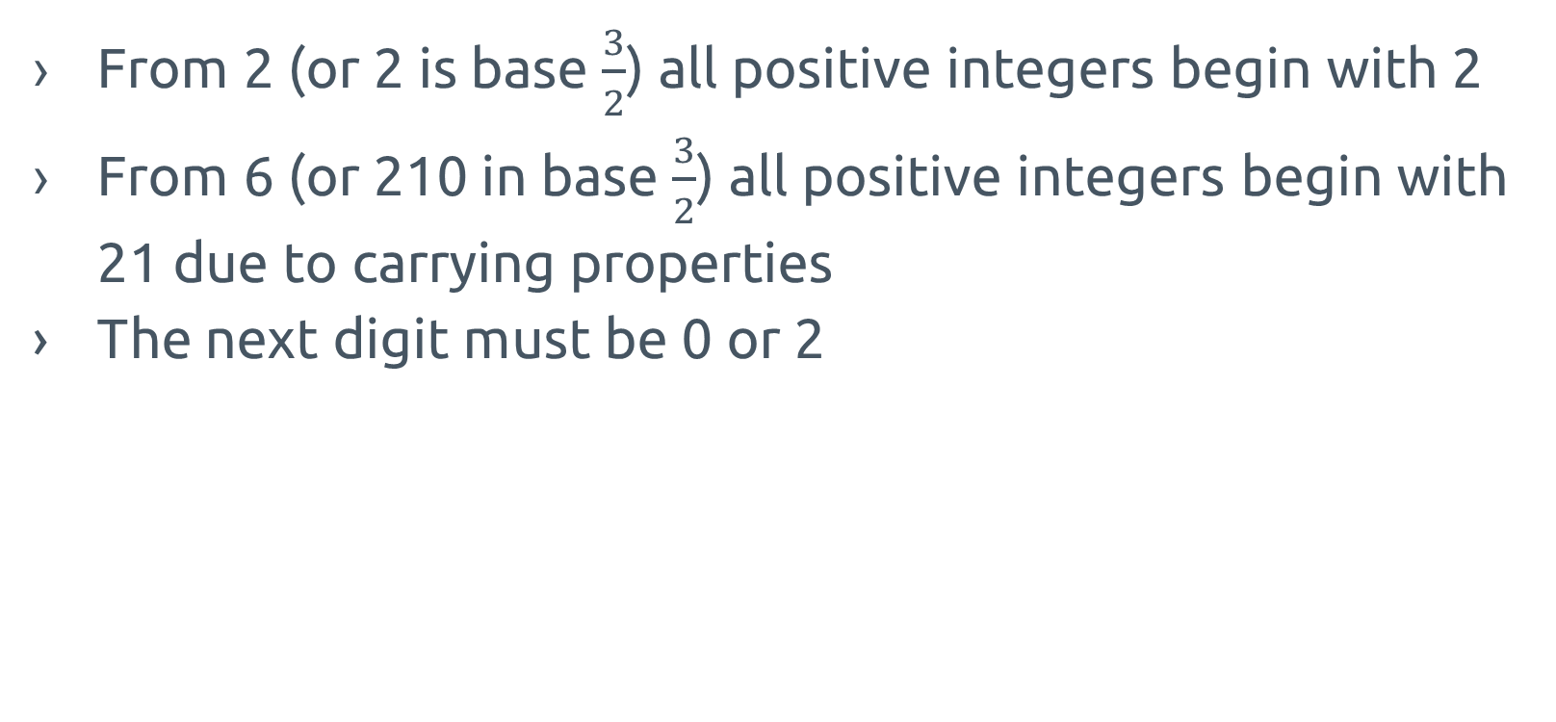
Beginning Digit Properties
From 2 (or 2 is base $\frac{3}{2}$) all positive integers begin with 2
From 6 (or 210 in base $\frac{3}{2}$) all positive integers begin with 21 due to carrying properties
The next digit must be 0 or 2
1 | 2 | 3 | 4 | 5 | 6 | 7 | 8 | 9 | 10 | 11 | 12 | 13 | 14 | 15
1 | 2 | 20 | 21 | 22 | 210 | 211 | 212 | 2100 | 2101 | 2102 | 2120 | 2121 | 2122 | 21012
Notes:
Richard

Slide 7
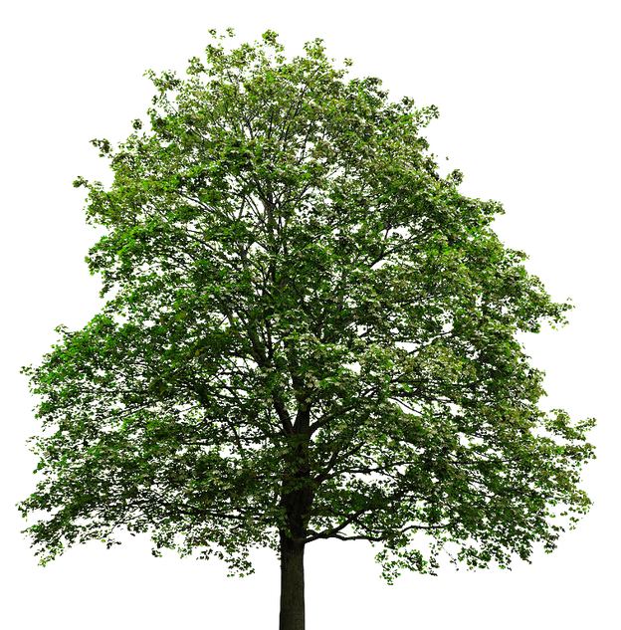
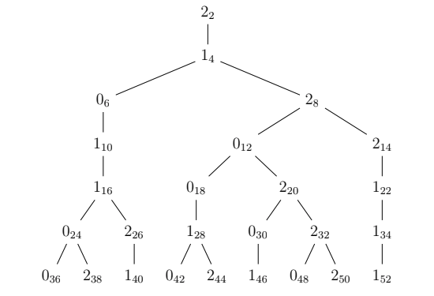
TREE
The subscript means the number in base 10
The number is the digit.
Notes:
Armaan

Slide 8
Ending Digits
There is a huge difference between beginning and the end
Last k digits repeat in a cycle with period 3^{k}
Any combination of last several digits is possible
Notes:
Armaan

Slide 9
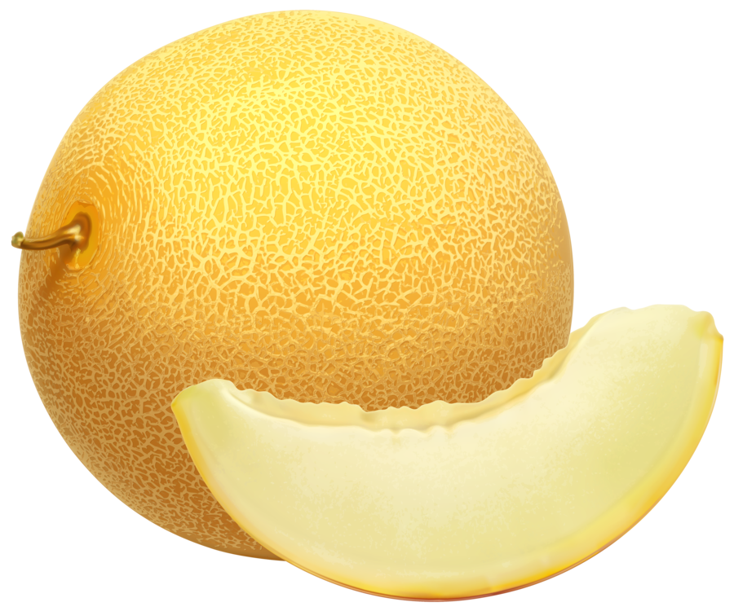

Some Definitions
ultimate evenmelon: the largest even integer of a certain length
take the right-hand side of the tree forever, an infinite string: 2122111221211221212112212112…
ultimate evenberry: the smallest even integer of a certain length
take the left-hand side of the tree forever, an infinite string: 2101100011010011010100110100…
Notes:
ADD LONGER NUMBERS
How long should the numbers be?
Anuj

Slide 10
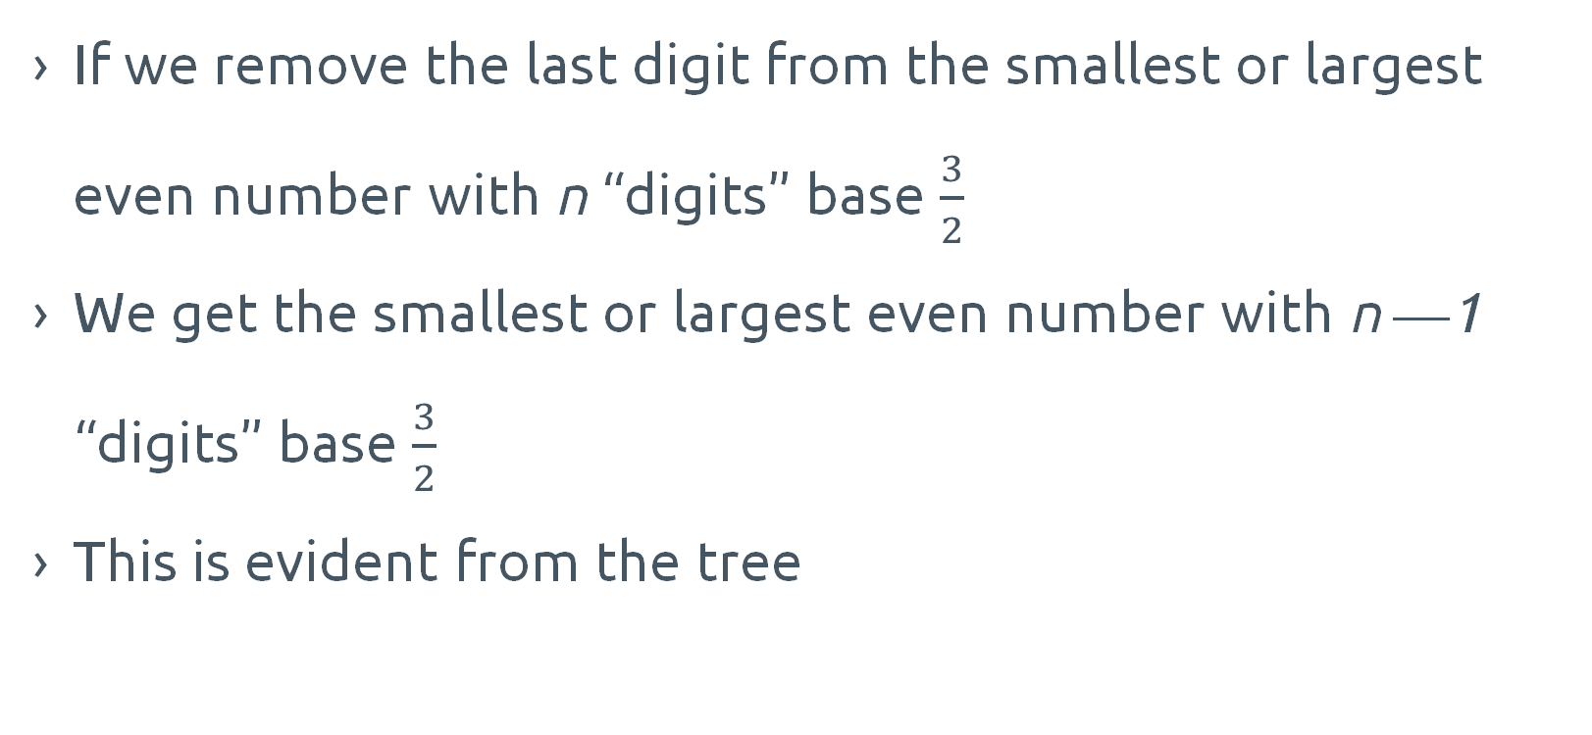
Largest/Smallest Even Integers
If we remove the last digit from the smallest or largest even number with n “digits” base $\frac{3}{2}$
We get the smallest or largest even number with n ⎼⎼1 “digits” base $\frac{3}{2}$
This is evident from the tree
Notes:
Anuj

Slide 11
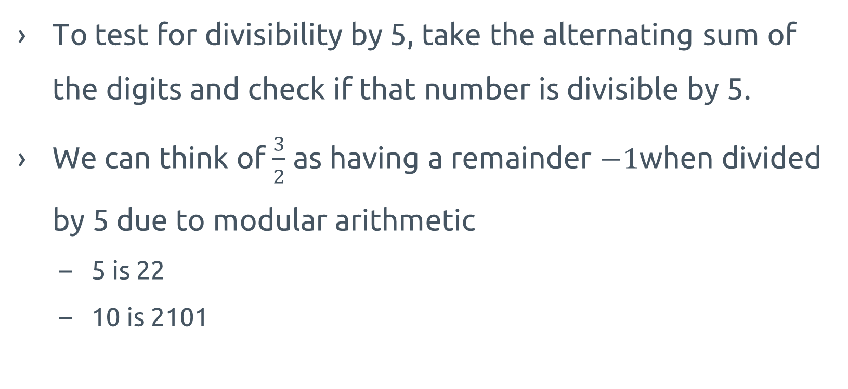
Divisibility
To test for divisibility by 5, take the alternating sum of the digits and check if that number is divisible by 5.
We can think of $\frac{3}{2}$ as having a remainder $−1$when divided by 5 due to modular arithmetic
  5 is 22
  10 is 2101
Notes:
EXPLANATION OF WHY REMAINDER –1
Richard-could be b/c 3/2 times 2=3 mod 5, so 3/2 is same as 4 mod 5(-1) b/c 4 times 2=3 mod 5
Shane

Slide 12
Sequences
Powers of 2&3, Look and Say, sorted Fibs, reverse sorted Fibs
Notes:
Ben

Slide 13
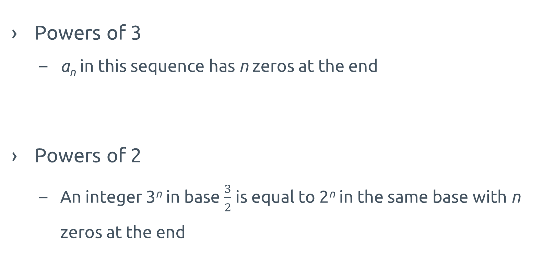
Powers of 3 and 2
1 | 20 | 2100 | 212000 | 210110000 | 21202200000
Powers of 3
  a_{n} in this sequence has n zeros at the end
Powers of 2
  An integer 3^{n} in base $\frac{3}{2}$ is equal to 2^{n} in the same base with n zeros at the end
1 | 2 | 21 | 212 | 21011 | 212022
Notes:
Ben

Slide 14
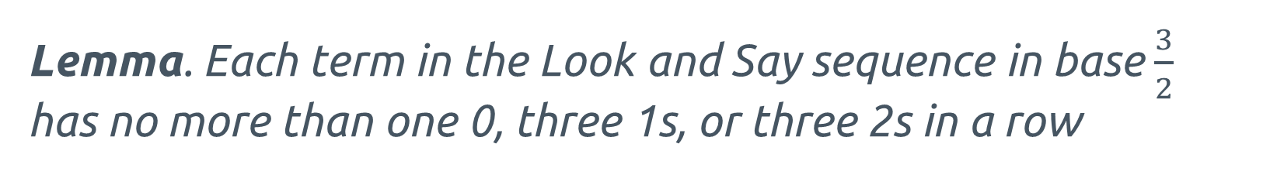

Look-and-Say
Base 10
1 | 11 | 21 | 1211 | 111221 | 312211 | 13112221
Base $\frac{3}{2}$
1 | 11 | 21 | 1211 | 111221 | 2012211 | 1210112221
Lemma. Each term in the Look and Say sequence in base $\frac{3}{2}$ has no more than one 0, three 1s, or three 2s in a row
Notes:
Ben

Slide 15
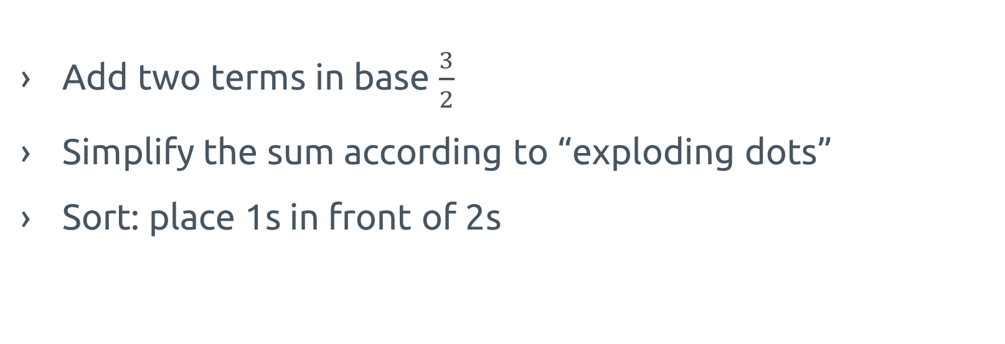
Fibs but not lies (sorted)
Add two terms in base $\frac{3}{2}$
Simplify the sum according to “exploding dots”
Sort: place 1s in front of 2s
Notes:
Josh

Slide 16

Sorted Fibs: eventual behavior
All sequences eventually turn into one of the following:
Pinocchio sequence
  2, 2, 12, 12, 112, 112, 1112, 1112, etc.
cyclic sequence
  112, 1122, 1122, 112, 1122, 1122, etc.
Notes:
Josh

Slide 17
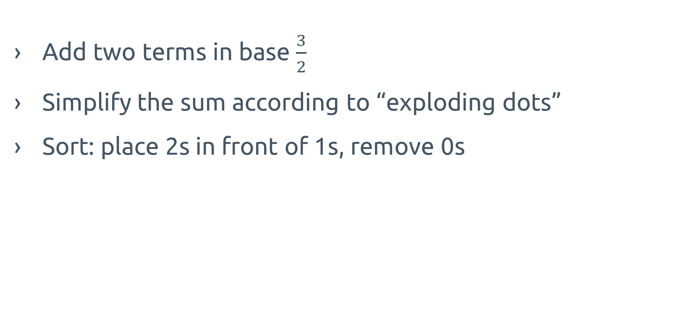
Reverse sorted Fibs: description
Add two terms in base $\frac{3}{2}$
Simplify the sum according to “exploding dots”
Sort: place 2s in front of 1s, remove 0s
Notes:
Neil

Slide 18

Reverse sorted Fibs: eventual behavior
All sequences eventually turn into one of the following:
Oihcconip sequence
  2211, 2211, 22211, 22211, 222211, 222211, etc.
a cyclic sequence (there are infinitely many)
  every element of such sequence has the same number of 2s (doesn’t matter what)
  there is one 1, then one 1, then two 1s
  2221, 2221, 22211, 2221, 2221, 22211, etc.
Notes:
Neil

Slide 19
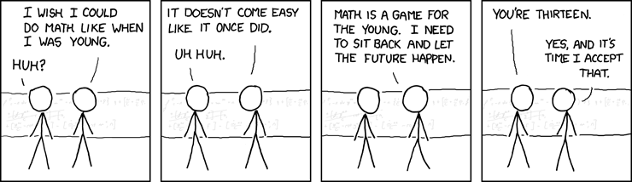
Thank you for watching!!
Notes:
Nastia

Slide 20

Acknowledgments
We would like to thank
Tanya Khovanova
PRIMES STEP
MIT
Notes:
Nastia

Slide 21

Acknowledgments
We would like to thank
James Propp
Glen Whitney
Parents
Notes:
Nastia

